Slide 1
FUNCTIONS
A FUNCTION IS A BLOCK OF CODE THAT EXECUTES ONE OR SEVERAL SQL SENTENCES FROM INPUT DATA (OPTIONAL) AND RETURNS A RESULT
THE SYNTAX TO CREATE A FUNCTION IS:
CREATE FUNCTION name (parameters...) RETURNS type
AND THEN SPECIFY WHAT THE FUNCTION SHOULD DO

Slide 2
FUNCTIONS
FOR EXAMPLE
LET'S DO A FUNCTION THAT SIMPLY ADDES THE TWO NUMBERS WE PASS AS PARAMETERS
CREATE FUNCTION ADD (num1 INT, num2 INT) RETURNS INT
BEGIN
DECLARE result INT;
SET result=num1+num2;
RETURN result;
END//
THE FUNCTION IS SAVED WITH THE NAME INDICATED. WE CAN INVOLVE IT WITH A SELECT, OR WITH ANY OTHER STATEMENT THAT RECOVERS THE RESULT AND EXECUTES ANY OPERATION WITH IT

Slide 3

FUNCTIONS
IMPORTANT !!
PLEASE NOTE THAT THE FUNCTION ENDS WITH END AND A BOUNDARY, IN OUR CASE IT IS //
CREATE FUNCTION ADD (num1 INT, num2 INT) RETURNS INT
BEGIN
DECLARE result INT;
SET result=num1+num2;
RETURN result;
END//
THIS BOUNDARY SHOULD BE SPECIFIED AT THE BOTTOM OF THE SCREEN WHEN WE CREATE THE FUNCTION

Slide 4
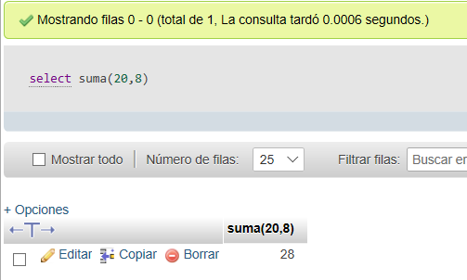
FUNCTIONS
INVOCATE A FUNCTION
IF WE JUST WANT TO SEE THE RESULT THAT RETURNS THE FUNCTION, WE CAN USE IT WITHIN A SELECT

Slide 5
FUNCTIONS
OF COURSE THE POWER OF SQL FUNCTIONS IS THAT WE CAN EXECUTE SQL SENTENCES WITH PARAMETERS THAT WE PASS TO THE FUNCTION
FOR EXAMPLE, IMAGINE THAT WE WANT TO KNOW HOW MANY ROOMS A HOTEL HAS
WE KNOW HOW TO DO IT, DON'T WE?
SELECT idHotel, nomHotel, COUNT(*)
FROM hotel NATURAL JOIN habitacio
WHERE idHotel=1;

Slide 6
FUNCTIONS
AND IF NOW WE WANT TO DO THE SAME AT THE HOTEL 3:
SELECT idHotel, nomHotel, COUNT(*)
FROM hotel NATURAL JOIN habitacio
WHERE idHotel=3;
AND EACH HOTEL OF WHICH WE WANT TO CALCULATE THE NUMBER OF ROOMS WE HAVE TO REPEAT THE SELECT BY CHANGING THE HOTEL NUMBER

Slide 7
FUNCTIONS
WITH FUNCTIONS:
CREATE FUNCTION comptahab (codihotel INT) RETURNS INT
BEGIN
DECLARE x INT;
SELECT COUNT(*) INTO x FROM habitacio
WHERE idHotel = codihotel;
RETURN x;
END//
NOTE THAT IT COUNTS HOW MANY ROOMS THE HOTEL WE HAVE PASSED AS PARAMETER
SAVE THE RESULT IN A VARIABLE x WE DECLARED
AND IN THE END THE RESULT RETURNS

Slide 8
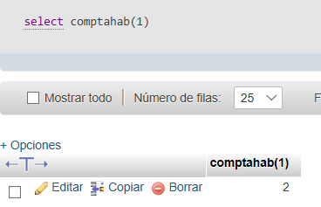
FUNCTIONS
NOW, IF WE WANT TO KNOW THE ROOMS THAT A DETERMINED HOTEL HAS
SELECT comptahab(1)
WE GET BACK THE NUMBER OF HOTEL ROOMS 1

Slide 9
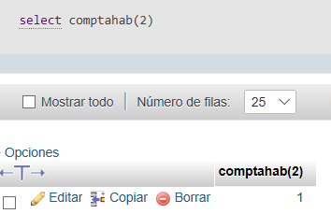
FUNCTIONS
NOW, IF WE WANT TO KNOW THE ROOMS THAT A DETERMINED HOTEL HAS
SELECT comptahab(2)
WE GET BACK THE NUMBER OF HOTEL ROOMS 2

Slide 10
FUNCTIONS
THE GREATEST UTILITY IS TO INCLUDE THE FUNCTION WITHIN ANOTHER GENERAL SELECT
SELECT idHotel, nomHotel, pobHotel, comptahab(idHotel) as "Habitacions"
FROM hotel
LIST THE HOTELS, AND SHOW THE NUMBER OF ROOMS IN EACH HOTEL WITHOUT NEEDING ACCESS TO THE ROOM TABLE NEITHER TO DO GROUP BY OR COUNT

Slide 11
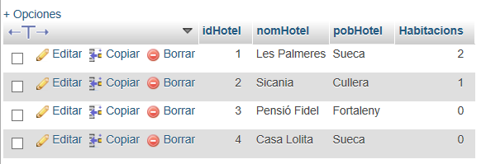
FUNCTIONS
THE GREATEST UTILITY IS TO INCLUDE THE FUNCTION WITHIN ANOTHER GENERAL SELECT
SELECT idHotel, nomHotel, pobHotel, comptahab(idHotel) as "Habitacions"
FROM hotel

Slide 12
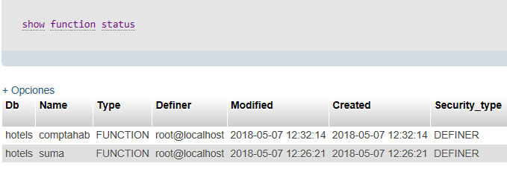
FUNCTIONS
IF WE WANT TO KNOW WHAT FUNCTIONS WE HAVE DESIGNED IN OUR DATABASE WE CAN DO
SHOW FUNCTION STATUS

Slide 13
FUNCTIONS
TO MODIFY THE CONTENT OF THE USER DEFINED FUNCTION YOU MUST DELETE AND CREATE AGAIN
DROP FUNCTION nom_funció
That's why it's a good idea to save the contents of your functions in separate files.

Slide 14
FUNCTIONS
TO MODIFY THE CONTENT OF THE USER DEFINED FUNCTION YOU MUST DELETE AND CREATE AGAIN
Another option is to do the following thing in all functions:
DROP FUNCTION IF EXISTS nom_funció;
DELIMITER //
CREATE FUNCTION nom_funció (...) RETURNS...
BEGIN
...
END;
DELIMITER ;

Slide 15
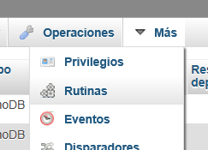
FUNCTIONS
TO MODIFY THE CONTENT OF THE USER DEFINED FUNCTION YOU MUST DELETE AND CREATE AGAIN
THE OTHER OPTION, IN RECENT VERSIONS OF PHPMYADMIN, IS TO GO TO THE DATABASE WHERE WE CREATED THE FUNCTION AND SEARCH FOR THE “ROUTINES” OR SIMILAR OPTION. THEY ARE ALL THERE, YOU CAN MODIFY, EDIT, EXECUTE AND CREATE NEW FUNCTIONS.

Slide 16
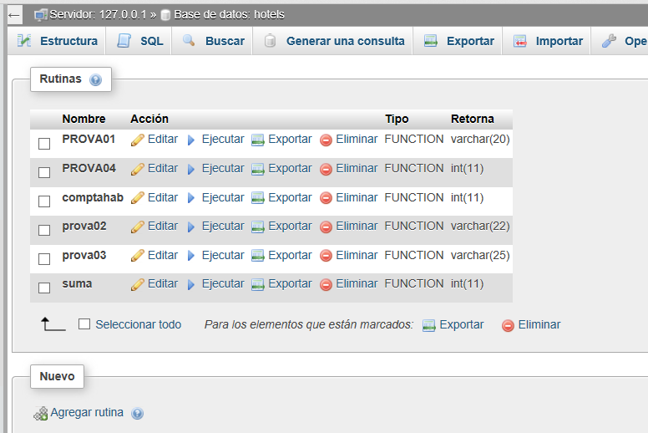
FUNCTIONS

Slide 17
FUNCTIONS
PREDEFINED FUNCTIONS
AS WITH OTHER LANGUAGES LIKE JAVA, THERE ARE FUNCTIONS THAT SQL ALREADY DEFINES
WE CAN USE THEM IN THE SAME WAY AS THOSE WE DEFINE
YOU CAN CONSULT THEM IN ANY MANUAL. THIS LIST IS COMPLETE COMPLETE AND CLASSIFIES FUNCTIONS BY TYPE
https://www.w3schools.com/sql/sql_ref_mysql.asp
Oficial manual MySQL: https://dev.mysql.com/doc/refman/5.7/en/func-op-summary-ref.html

Slide 18
FUNCTIONS
PREDEFINED FUNCTIONS
EXAMPLES
CONCATENATE TWO OR MORE EXPRESSIONS (GENERAL OF VARCHAR TYPE)

Slide 19
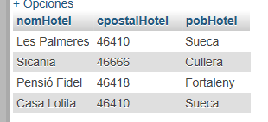
FUNCTIONS
PREDEFINED FUNCTIONS
EXAMPLES: CONCAT
SELECT nomHotel, cpostalHotel, pobHotel FROM hotel

Slide 20
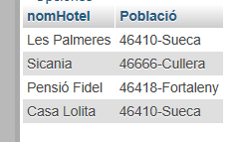
FUNCTIONS
PREDEFINED FUNCTIONS
EXAMPLES: CONCAT
SELECT nomHotel, CONCAT(cpostalHotel, "-", pobHotel) AS "Població"
FROM `hotel`
CONCATENATE THE ZIP CODE, A HYPHEN AND THE POPULATION AND SHOW IT AS IF IT WERE A SINGLE ATTRIBUTE

Slide 21
FUNCTIONS
PREDEFINED FUNCTIONS
EXAMPLES: SUBSTR
IN THE SUBSTRING FUNCTION WE CAN REQUEST THAT BACK A PART OF A CHAIN, STARTING IN THE POSITION WE REQUEST YOU, WELL UNTIL THE END WELL THE NUMBER OF CHARACTERS WE ASK FOR
substr(cadena, 5) // returns us from the string character 5 to the end
substr(cadena, 5, 4) // returns us the next 4 characters from the
// 5 character of the string

Slide 22
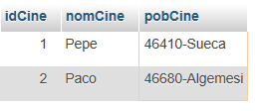
FUNCTIONS
PREDEFINED FUNCTIONS
EXAMPLES: SUBSTR
IMAGINE THAT WE NOW HAVE THE ZIP CODE AND THE POPULATION TOGETHER IN A SINGLE ATTRIBUTE
SELECT * FROM `cine` WHERE pobCine LIKE "46%"

Slide 23
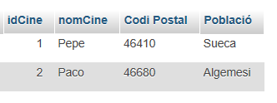
FUNCTIONS
PREDEFINED FUNCTIONS
EXAMPLES: SUBSTR
WE CAN SHOW THE POSTAL CODE ON THE ONE PART, AND THE POPULATION ON THE OTHER, IF WE DO
SELECT idCine, nomCine, SUBSTRING(pobCine,1,5) AS "Codi Postal",
SUBSTRING(pobCine,7) AS "Població"
FROM `cine` WHERE pobCine LIKE "46%"

Slide 24

FUNCTIONS
PREDEFINED FUNCTIONS
EXAMPLES: ROUND
THE ROUND FUNCTION ROUNDS THE CERTAIN NUMBER TO A CERTAIN QUANTITY OF DECIMALS
SELECT ROUND(122.443234, 2)
UNITAT 8: FUNCIONS ESTEFANIA.M

Slide 25


FUNCTIONS
PREDEFINED FUNCTIONS
EXAMPLES: ROUND
WE CAN USE IT TO SHOW THE RESULT OF CERTAIN CALCULATIONS WITH A LIMITED QUANTITY OF DECIMALS
SELECT AVG(souEmp) FROM `empleat` WHERE idHotel = 2
SELECT ROUND(AVG(souEmp), 2) FROM empleat WHERE idHotel=2

